Slide 1


FoodieRover CDR
Group 29

Slide 2



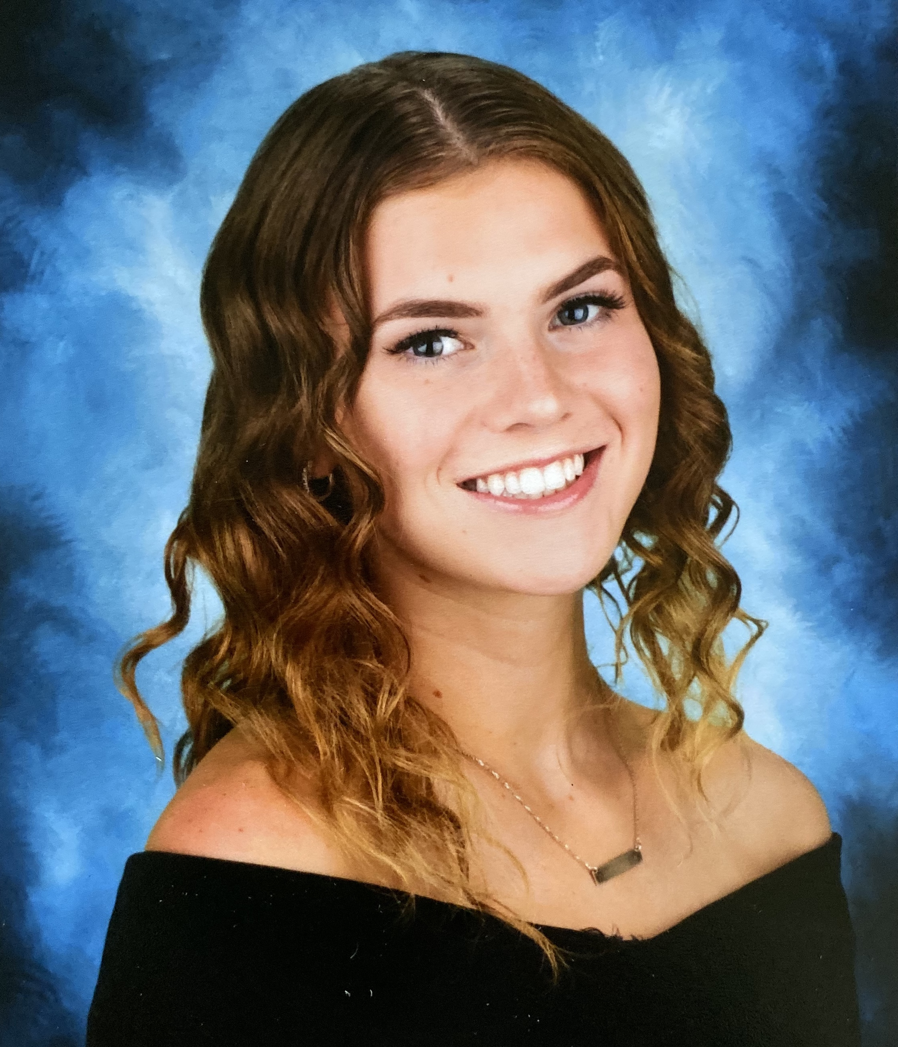
Team Members
Mauricio Ferrari Computer Engineer
Chidoziri Maghiro Electrical Engineer
Antonia Soto Electrical Engineer
Alexis Gyselinck Electrical Engineer

Slide 3
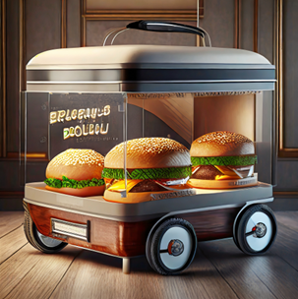
Motivation & Description
Reduce time wasted waiting for orders from busy campus restaurants.
Provide full-time students with a more efficient lunch break.
Enhance productivity by eliminating the need to leave workspaces for meals.
Autonomous ground vehicle that doubles as a food convoy.
Integrates Google Maps’ Directions API for path planning.
Companion mobile application for user interactivity.
Mauricio Ferrari - CE

Slide 4
Goals
Basic Goals
Path planning done remotely
Food is safely stored with a magnetic lock
Companion app can communicate arrival and passcode
Detect static objects
Advanced Goals
Detect dynamic objects
Obstacle avoidance (rerouting)
Track FoodieRover from app
Implement neural network to identify objects
Mauricio Ferrari - CE

Slide 5
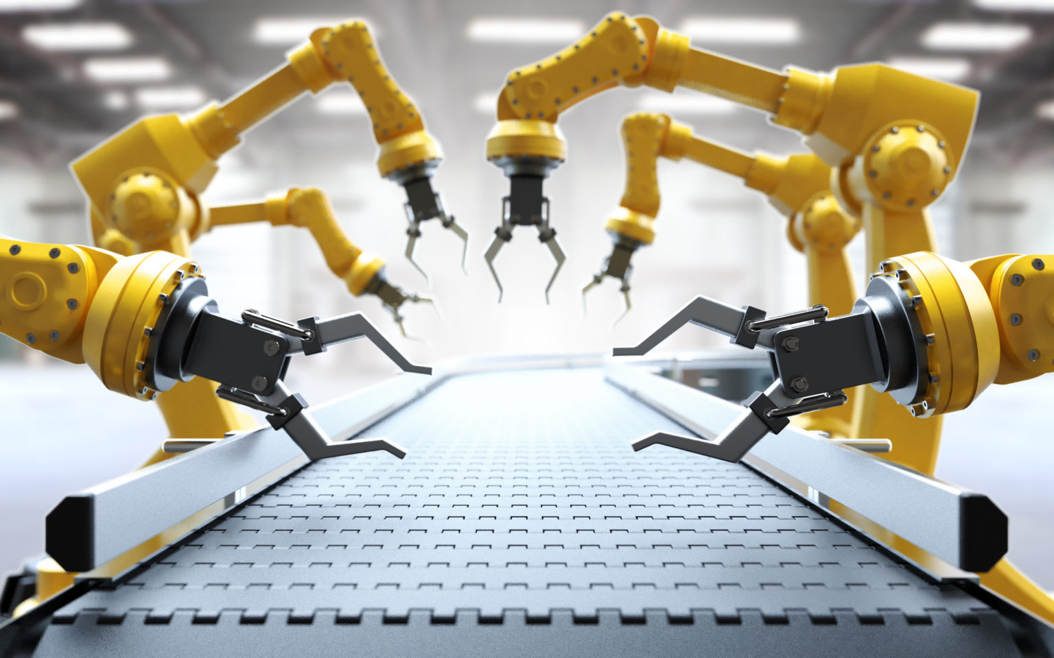

Engineering Specifications:
Robot Dimensions​ | >= 1 cubic foot​
Speed​ | >=1 mph​
Travel Distance​ | 200 meters per trip​
Weight capacity of food​ | <= 3 lbs​
Battery Life​ | 1-2 Hours​
Circular sensing area​ | 360 degrees​
Radius of sensing area​ | >= 1 meter​
Computer Vision​ | 1 camera​
Power consumption when on Go​ | 400 W​
Idle power consumption when resting​ | 50 W​
API Connection​ Delay | <= 5 sec​
Locking/Unlocking via Keypad​ | 95% accuracy​
Chidoziri Maghiro - EE

Slide 6
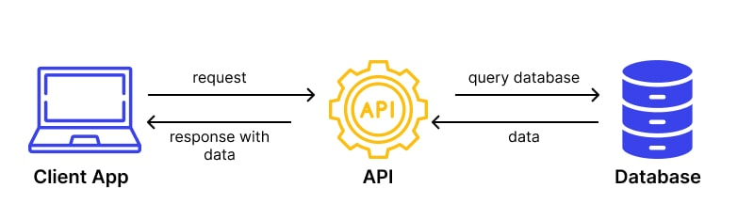
API Connection abilities
A key component of the software is its API capabilities.
This would require FoodieRover to have a wifi-chip so that it can make the API calls.
As of now, the two servers we’re looking to contact are Google Maps and the eventual server of the application.
Chidoziri Maghiro - EE

Slide 7
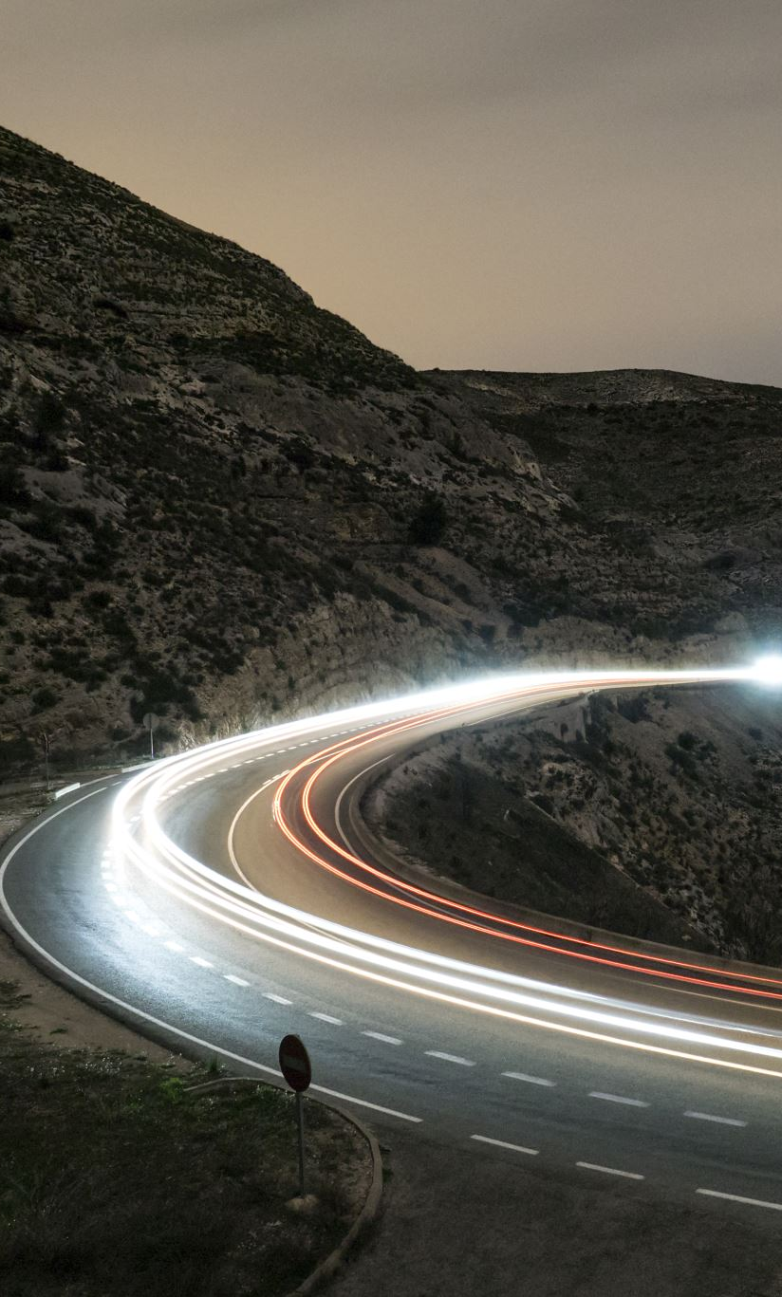
Additional features
FoodieRover runs on continuous tracks, rather than rubber wheels, which increases the area of contact with the ground and allows for smoother travel over a variety of surfaces.
The interior compartment where food is held will be insulated in order to keep food at the right temperature during delivery.
A unique passcode is set for each delivery to prevent theft of food materials.
Chidoziri Maghiro - EE

Slide 8
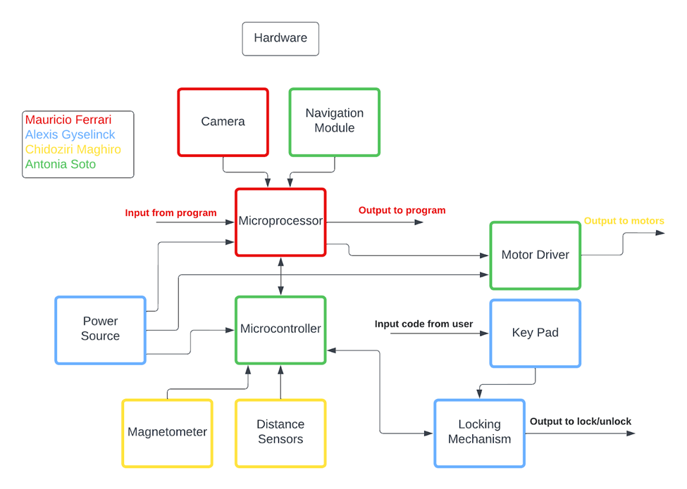
Hardware Design - Global Block Diagram
Alexis Gyselinck - EE

Slide 9
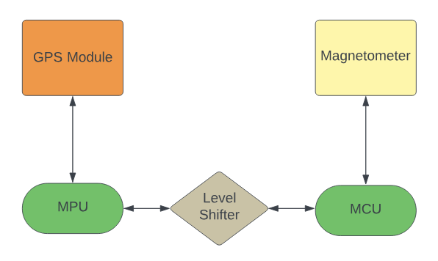
Hardware Design - Navigation System
Alexis Gyselinck - EE

Slide 10
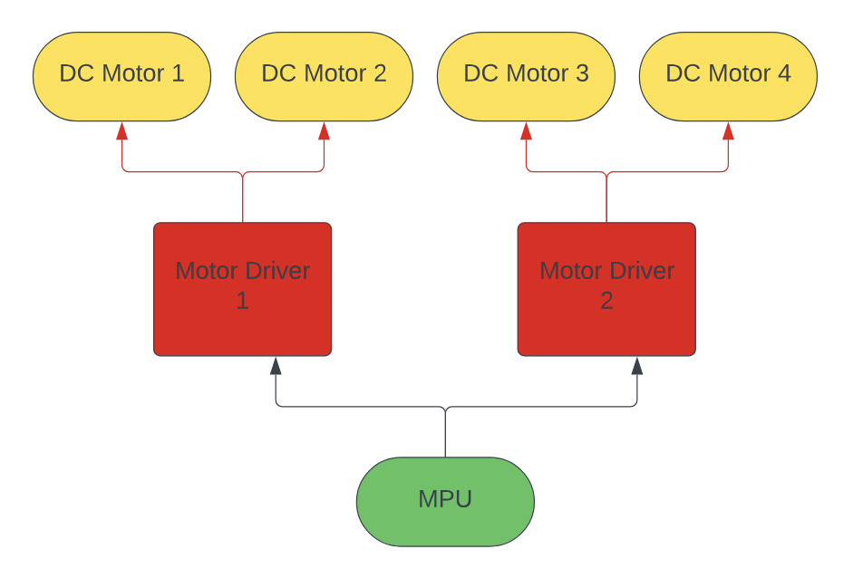
Hardware Design - Motor System
Alexis Gyselinck - EE

Slide 11
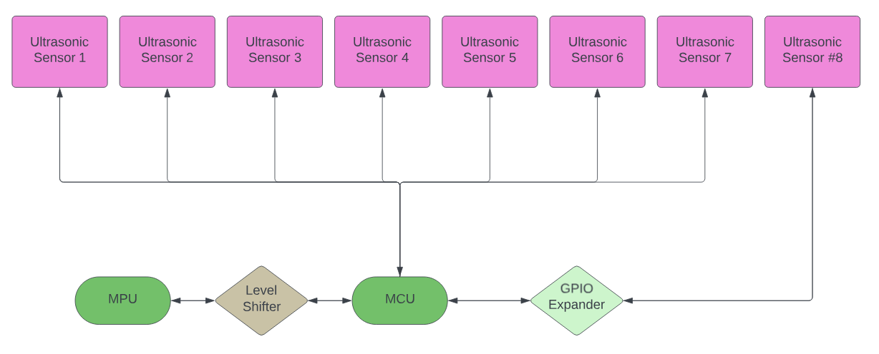
Hardware Design - Sensor System
Alexis Gyselinck - EE

Slide 12
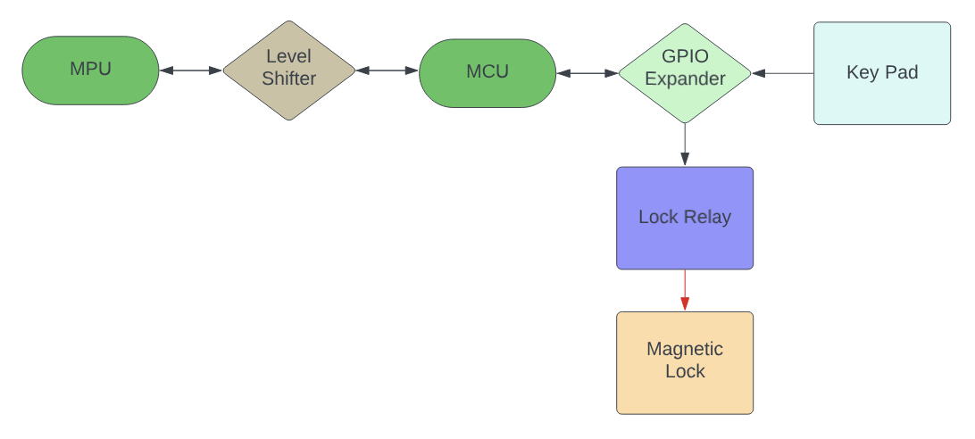
Hardware Design - Locking System
Alexis Gyselinck - EE

Slide 13
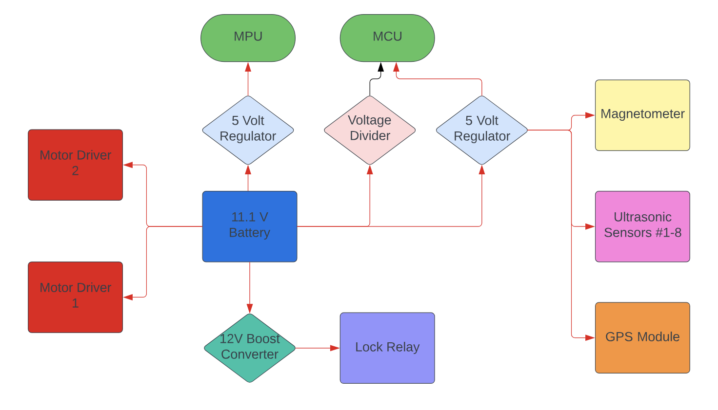
Hardware Design - Power System
Alexis Gyselinck - EE

Slide 14
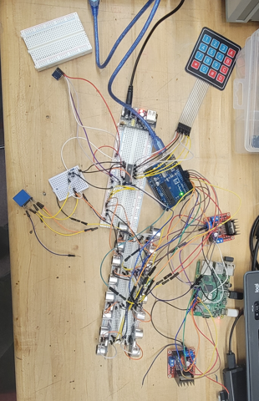

Hardware
Microprocessor & Microcontroller
GPIO Expander
Bi-Directional Logic Level Converter
Motor Drivers
DC motors
Sensor array: Ultrasonic Ranging Module
Navigation hardware: Magnetometer & GPS module
Locking Mechanism: Magnetic lock, Keypad & Relay
Battery
Fuses
LiPro Balance charger
Antonia Soto – EE

Slide 15
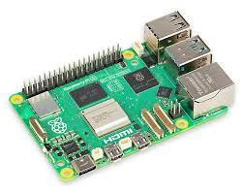
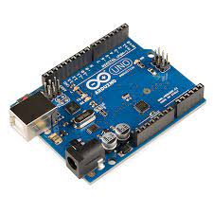
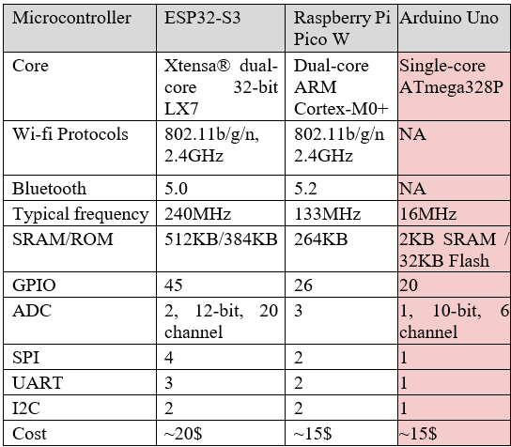
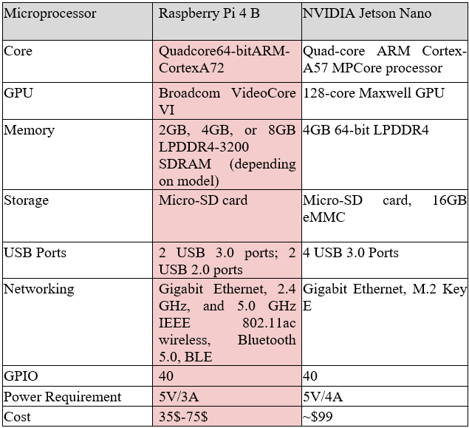
Raspberry Pi 4 Model B & Arduino Uno
Using an MPU:​
Full operating system​
Network connectivity
Using an MCU:
Real time communications
Connectivity (GPIOs)
They are complementary in their application for FoodieRover
Antonia Soto – EE

Slide 16
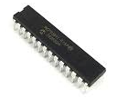
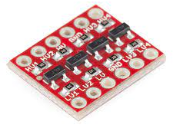
GPIO Expander & Level Shifter
To accommodate the extensive connectivity requirements for sensors and peripherals on the Arduino Uno, we employ an MCP23017 GPIO expander.
16 additional I/O ports
I2C interface
To ensure safe and reliable communication between the 3.3V Raspberry Pi board and the 5V Arduino Uno, we employ the BOB-12009 level shifter.
Voltage compatibility with bi-directional communication
High speed data transmission
Both offer cost-effective solutions with ease of integration to the system
Antonia Soto – EE

Slide 17
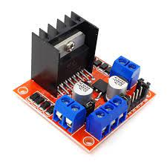
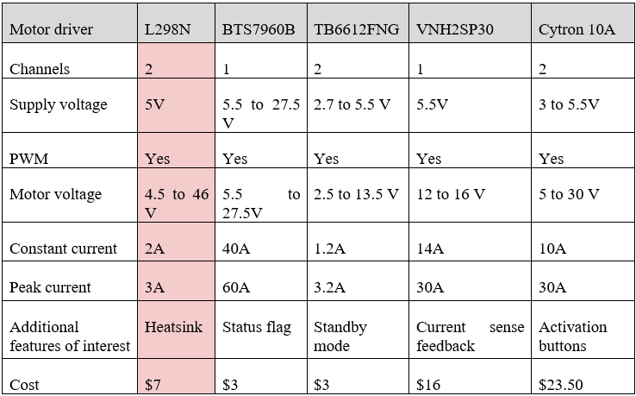
Motor Drivers
The FoodieRover chassis comes with four 12V DC motors. There is the need to control the direction and speed for each of the motors by a controller for effective maneuvering.
We are using two L298N Dual H-Bridge Motor Drivers
Dual bidirectional control of two motors
Up to 2A output per motor
Power LED indicators for operational monitoring
Compatible with microcontrollers and manual control setups
Chidoziri Maghiro - EE

Slide 18
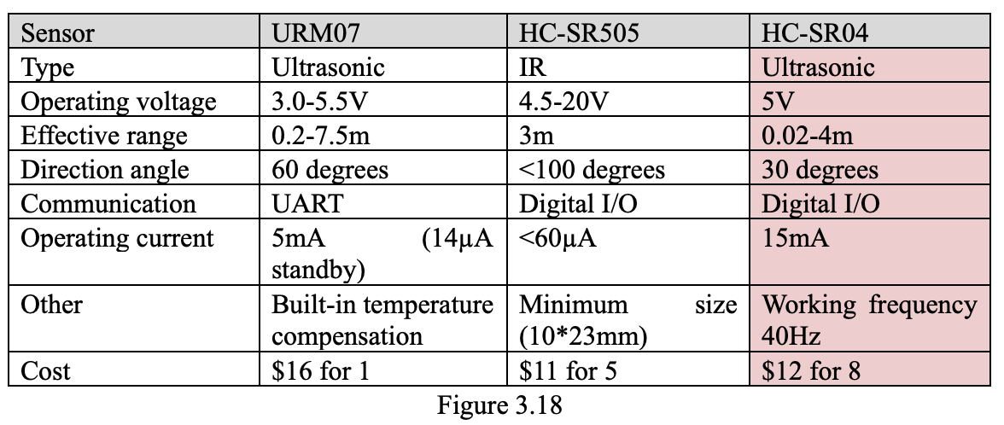
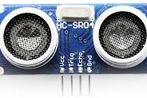
Ultrasonic Ranging Module
To provide FoodieRover with the ability to sense object within two meters of distance and provide comprehensive spatial detection. We are implementing the Ultrasonic Ranging Module HC - SR04.
Ultrasonic: widely used for automotive applications
Accurate readings from 2cm to 400cm
Cone shape measuring angle of approx. 15 degrees
Digital I/O communication
Cost-effective and easy of integration
Implementing 8 sensors for each face and corner of the bot.
Chidoziri Maghiro - EE

Slide 19
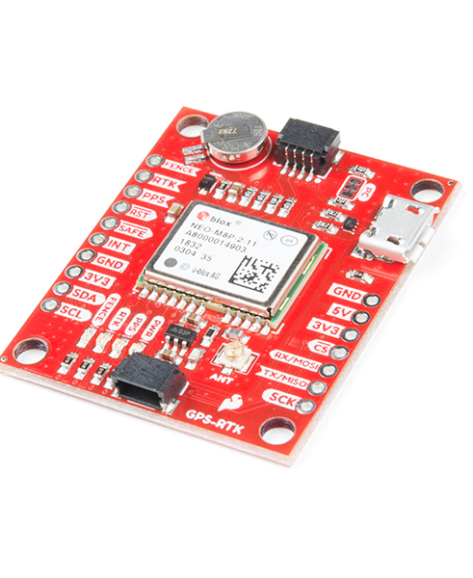
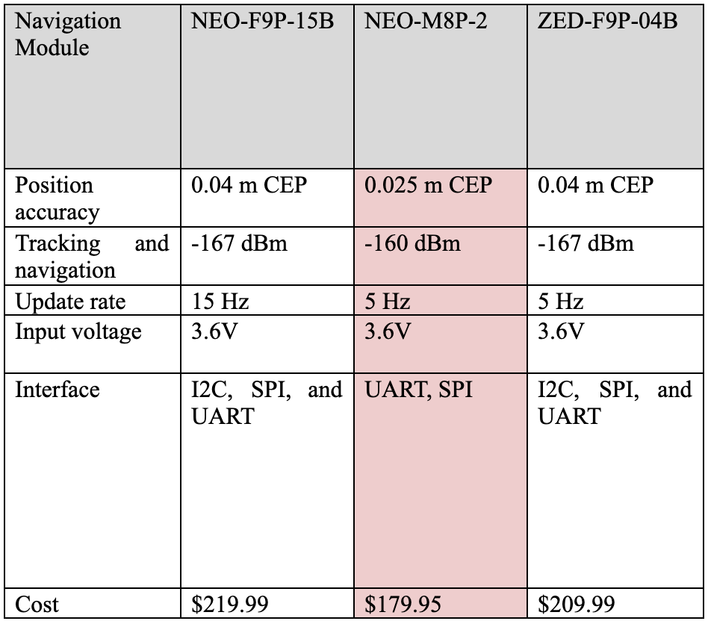
GPS Module
SparkFun GPS-RTK Board - NEO-M8P-2
Enables the application of real time kinematics – necessary for specific geolocation
Accuracy: 0.025 m (w/ RTK)
Moving baseline RTK - 4 Hz
Price: $179.95
Requires RTCM correction stream:
Florida DOT
Polaris
Mauricio Ferrari - CE

Slide 20
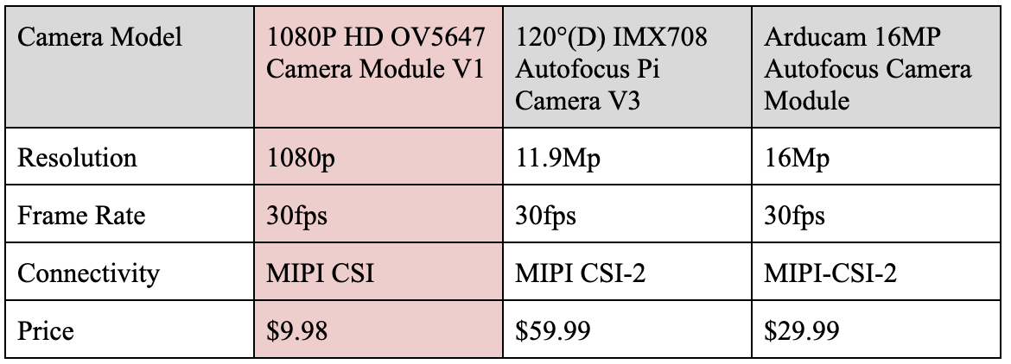
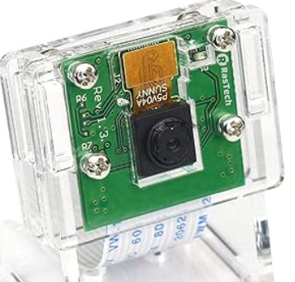
Rasp Pi Camera Module 0V5647
This camera module is popular in Raspberry Pi projects and implements well with TensorFlow Lite applications.
5 MP
1080p @ 30 fps
720p @ 60 fps
Field of View: 2.0 x 1.33m at 2 m
15-pin MIPI camera serial interface
Mauricio Ferrari - CE

Slide 21
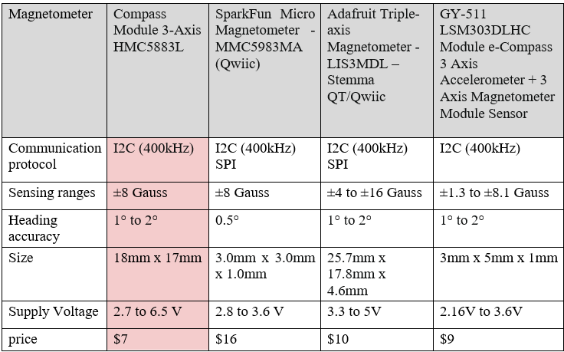
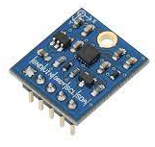
Magnetometer
To give FoodieRover a sense of direction for navigation we are incorporating the Compass Module 3-Axis HMC5883L to leverage the Earth’s magnetic field.
3-Axis magnetoresistive sensor
1 to 2 degree compass heading accuracy
I2C communication interface
Low power consumption and compact
Chidoziri Maghiro - EE

Slide 22
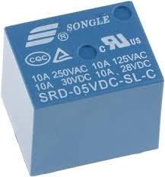
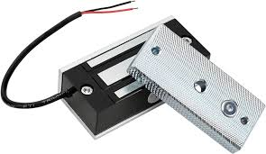
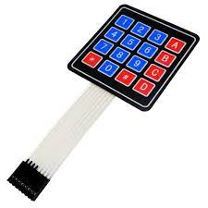
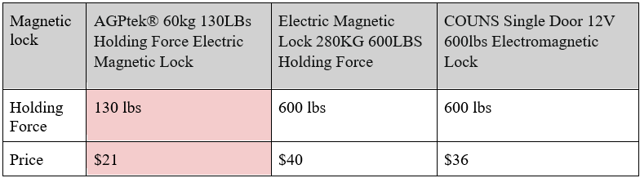
Magnetic lock, Keypad & Relay
FoodierRover’s lock mechanism to keep the food stored safely consists of the following components:
AGPtek® 60kg 130LBs Holding Force Electric Magnetic Lock
Relay: SRD-05VDC-SL-C
4x4 KeyPad
Antonia Soto – EE

Slide 23
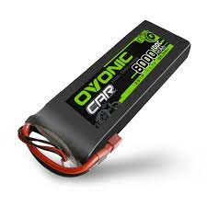
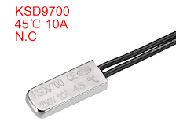
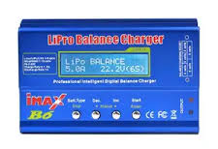
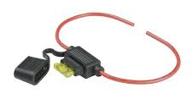
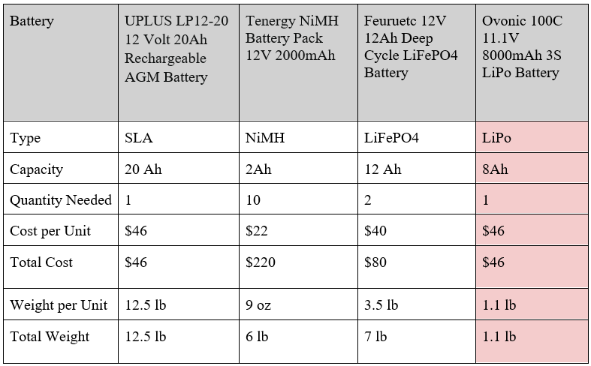
Battery
Ovonic 100C 11.1V 8000mAh 3S LiPo Battery
High energy density
Lightweight and compact
Fast Recharge Times
Low Self-Discharge Rate
Safety: current fuse (10A), thermal switch (45C), and LiPro Balance charger.
Antonia Soto – EE

Slide 24
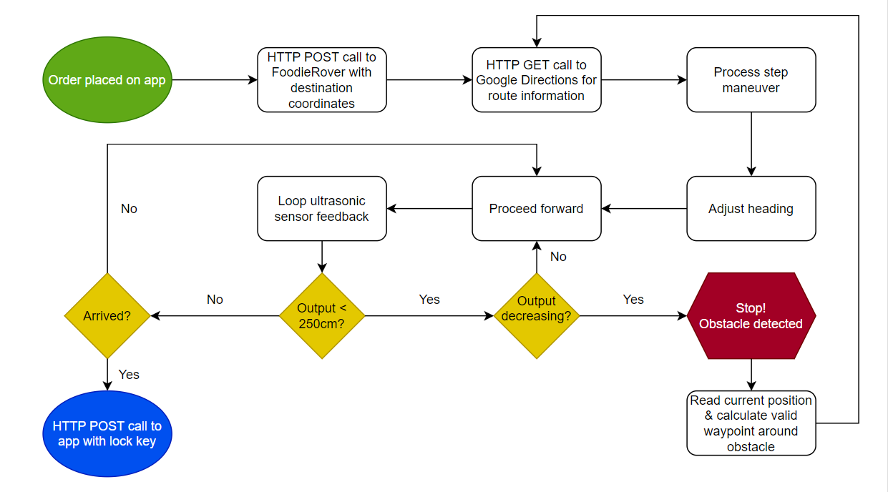

Software Design
Mauricio Ferrari - CE

Slide 25
Comparison of Software
 | Python | C++ | JavaScript
Software/Frame-work | ROS | Arduino IDE | React Native
Memory Management | Automatic Memory Management | Manual Memory Management | Automatic Memory Management
Speed | Slower due to interpretation and dynamic typing | Faster thanks to compilation to native machine code | Generally considered between Python and C
Other | OpenCV, TensorFlow libraries |  | Supports server-side scripting
Mauricio Ferrari - CE

Slide 26
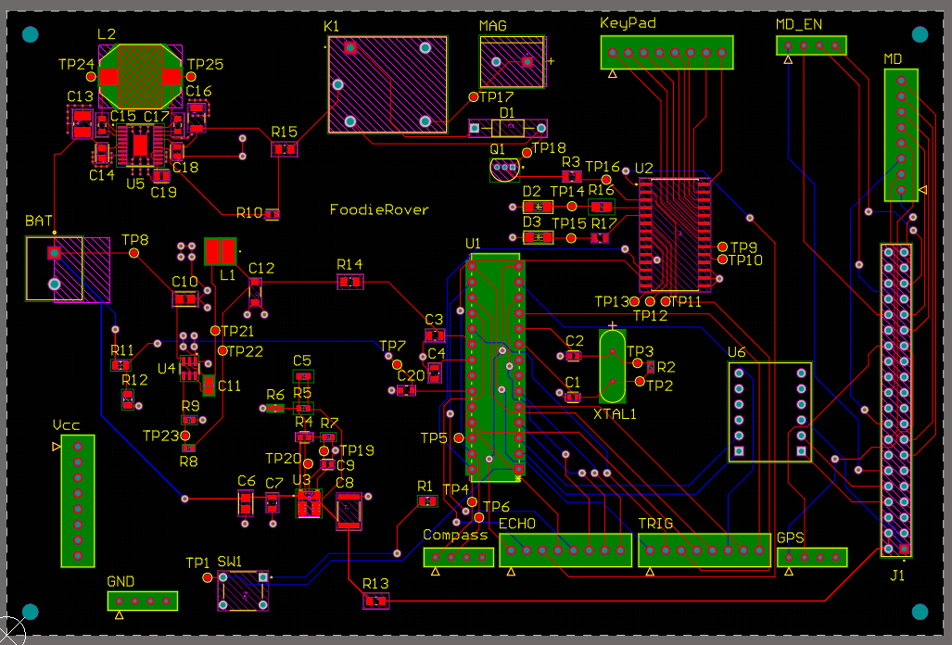
PCB Design
Microcontroller: ATMEGA328P
Level Shifter: BOB-12009
GPIO Expander: MCP23017
Relay: SRD-05VDC-SL-C
Voltage Regulators
tps561201 (5V1A)
tpsm863252 (5V3A)
tps55165-q1 (12V1A)
Connectors & Connector to Raspberry Pi
Antonia Soto – EE

Slide 27
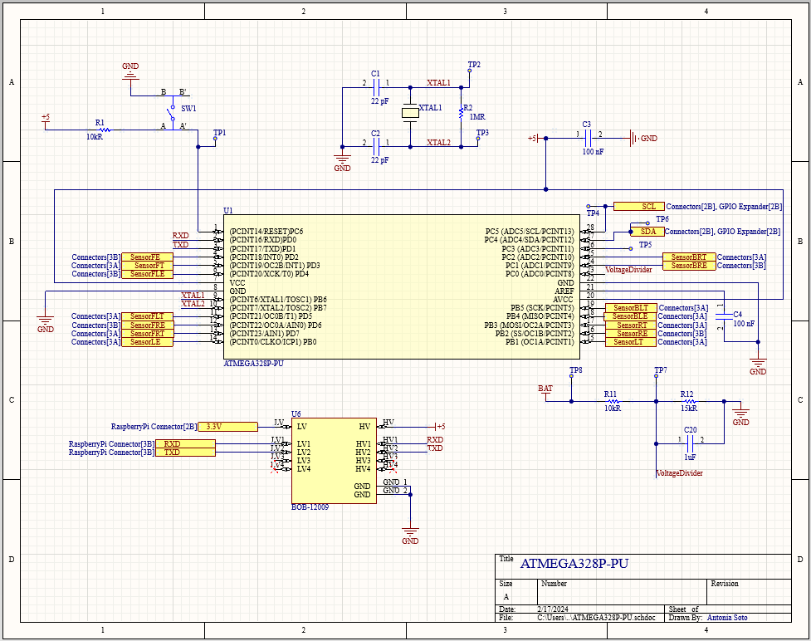
Microcontroller: ATMEGA328P
Voltage Divider
Level Shifter: BOB-12009
Antonia Soto – EE

Slide 28
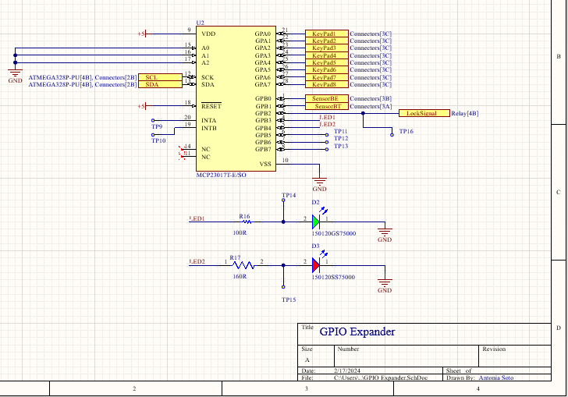
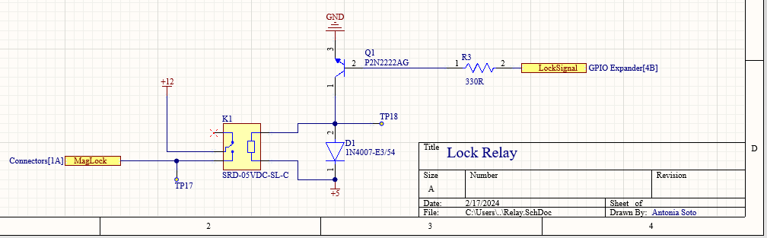
GPIO Expander: MCP23017
Relay: SRD-05VDC-SL-C
Antonia Soto – EE

Slide 29
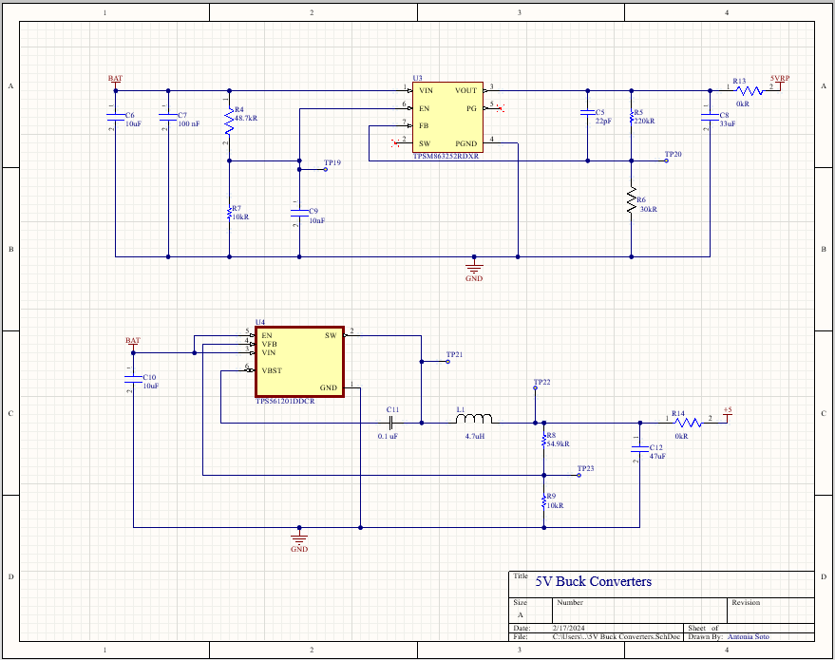
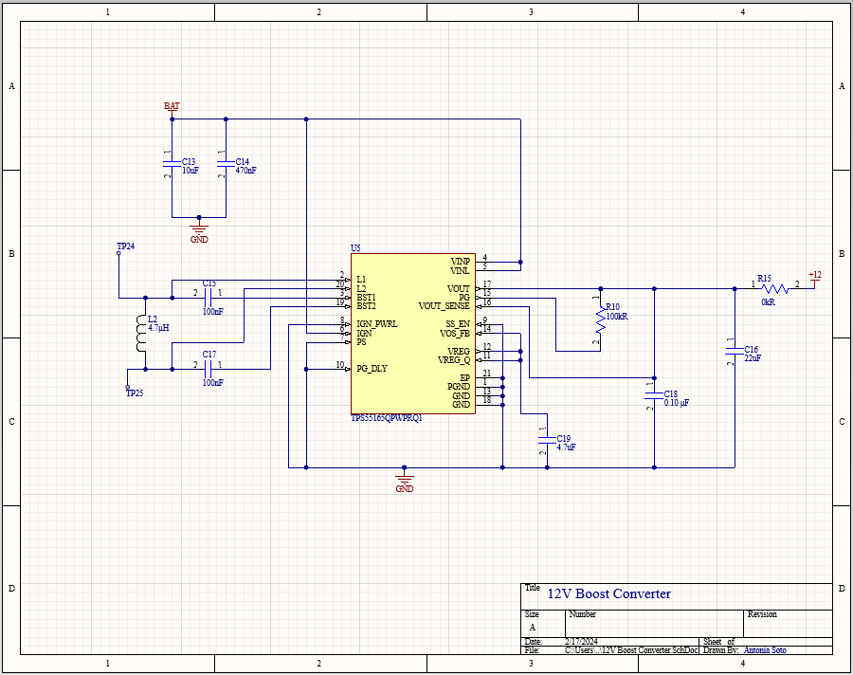
5V Buck Converters
tpsm863252 (5V3A)
tps561201 (5V1A)
12V Boost Converter
tps55165-q1 (12V1A)
Antonia Soto – EE

Slide 30
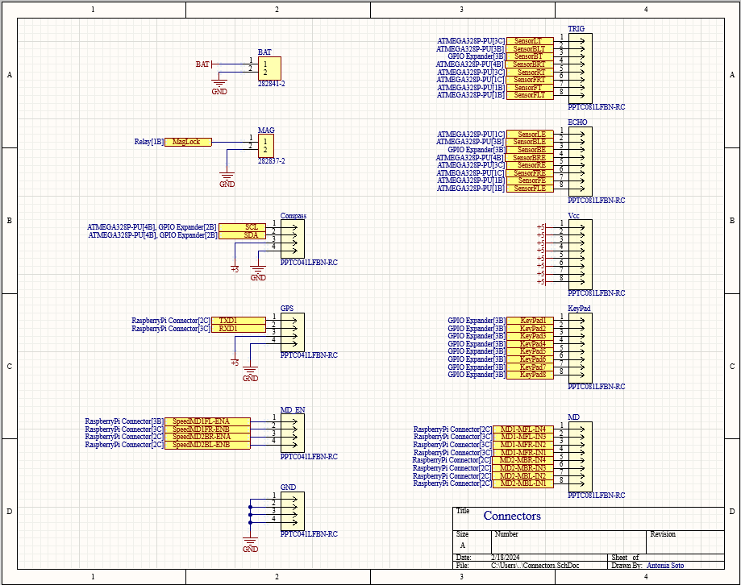
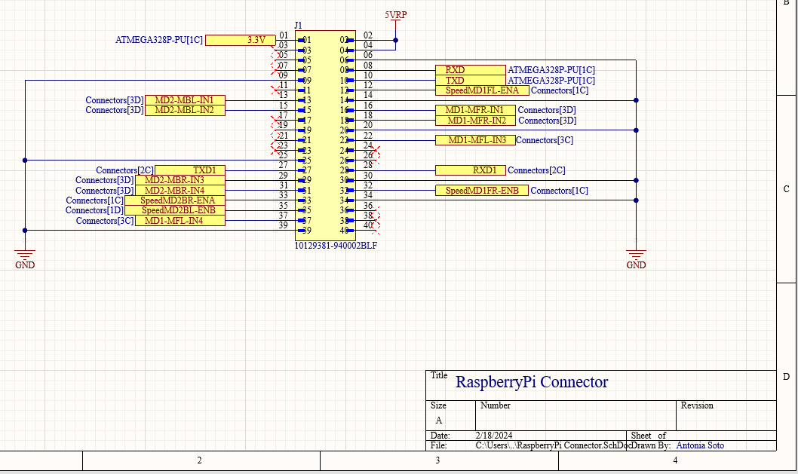
Connectors to Peripherals
Connector to Raspberry Pi
Antonia Soto – EE

Slide 31
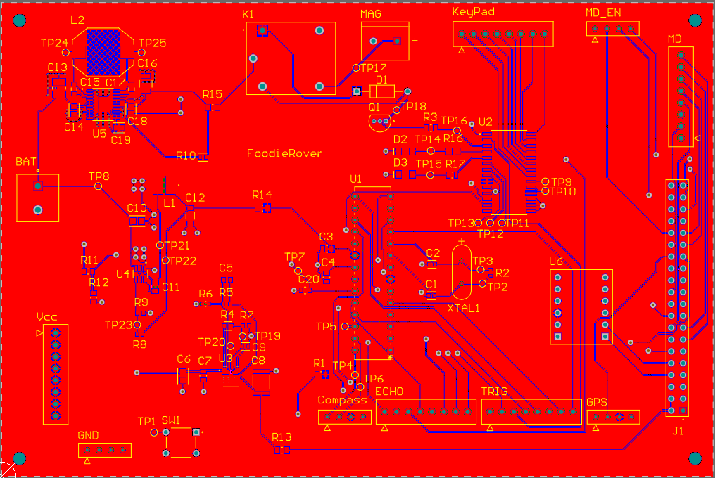
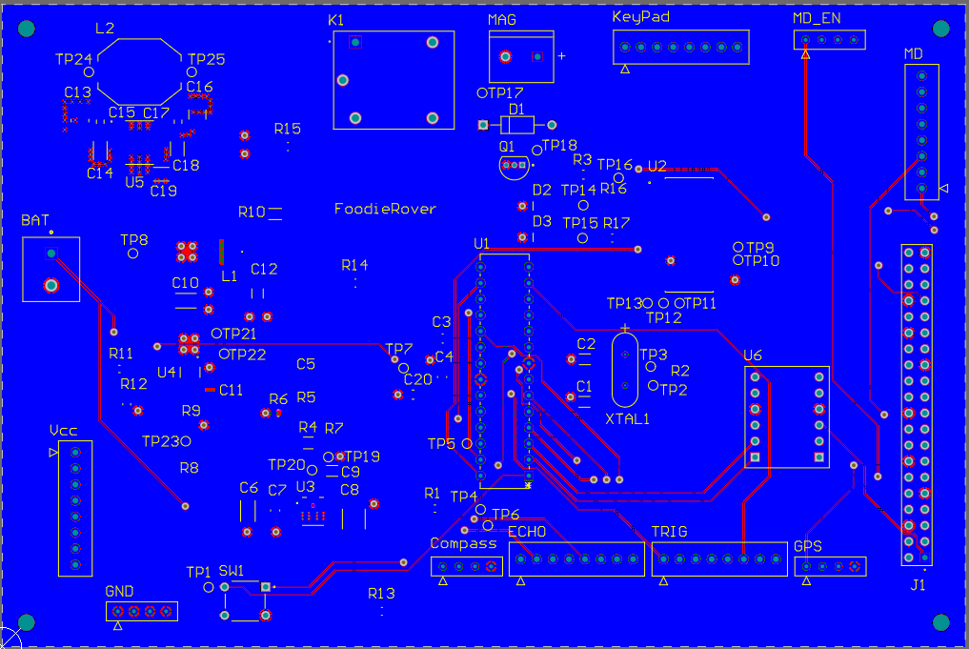
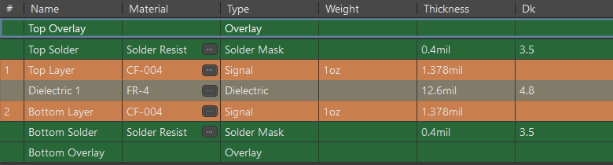
Top Layer
Bottom Layer
Layer Stack Manager
Antonia Soto – EE

Slide 32
Budget
ITEM | QUANTITY | PRICE | TOTAL COST
Magnetometer | 1 | $11 | $11
GPS Module | 1 | $25 | $25
Motors | 2 | $26 | $52
Robot Chassis | 1 | $170 | $170
MPU | 1 | $32 | $32
Motor Drivers | 2 | $15 | $30
Ultrasonic Sensors | 8 | $9 for 5 | $18
Keypad | 1 | Previously owned | -
Battery | 1 | $43 | $43
GPIO Expander | 1 | $9 | $9
Level Shifter | 1 | $4 | $4
Lock Relay | 1 | $4 | $4
Magnetic Lock | 1 | $21 | $21
Cooler | 1 | $34 | $34
API | 1 | $30 | $30
PCB & Associated Components | 5 | - | $102
TOTAL |  |  | $585
Alexis Gyselinck - EE

Slide 33
Work Distribution
Component | Primary Member | Secondary Member
Communication Module | Mauricio | Alexis
Software | Mauricio | All
Motor System | Chidoziri | Alexis
Magnetometer | Chidoziri | Alexis
Ultrasonic Sensors | Chidoziri | Antonia
Microprocessor | Antonia | Mauricio
PCB | Antonia | All
Navigation Module | Antonia | Mauricio
Locking System | Alexis | Chidoziri
Power System | Alexis | Chidoziri
Alexis Gyselinck - EE

